Slide 1
Software Testing

Slide 2
Software quality
Software quality is:
1. The degree to which a system, component, or process meets specified requirements.
2. The degree to which a system, component, or process meets customer or user needs or expectations.

Slide 3
An effective quality process must focus on
Paying much attention to customer’s requirements
Even a bug-free program is a failure if it doesn't solve the customer's problem.
Making efforts to continuously improve quality
It involves analyzing test results from the previous sprint to improve the testing strategy for the next one.
Integrating measurement processes with product design and development
You cannot manage what you cannot measure. An effective process uses data to drive decisions rather than "gut feelings.“
Quality must be measured during design and development, not just after
Pushing the quality concept down to the lowest level of the organization
Quality is not the sole responsibility of the "QA Department." It is a cultural mindset that must be shared by every developer, designer, and product manager.
This encourages Total Quality Management (TQM).

Slide 4
An effective quality process must focus on
Developing a system-level perspective with an emphasis on methodology and process
A "system-level perspective" means looking at the software as a whole rather than as isolated functions. This requires a standardized methodology (like Agile, DevOps, or V-Model).
Eliminating waste through continuous improvement
Derived from Lean Manufacturing, eliminating waste (Muda) in software means removing any activity that does not add value to the final product.

Slide 5
Software Quality
ISO 9126
The ISO 9126 quality model was developed by an expert group under the aegis of the International Organization for Standardization (ISO).
The document ISO 9126 defines six broad, independent categories of quality characteristics
functionality, reliability, usability, efficiency, maintainability, and portability
CMM
In the CMM framework, a development process is evaluated on a scale of 1–5, commonly known as level 1 through level 5. For example, level1 is called the initial level, whereas level 5—optimized—is the highest level of process maturity.

Slide 6
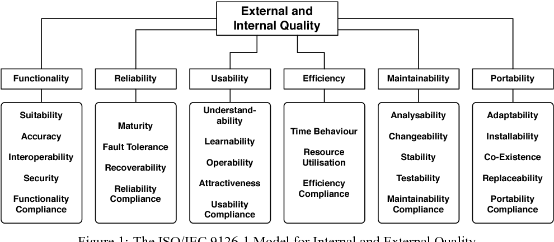

Slide 7
Functionality
This attribute refers to the software's ability to provide the functions that meet stated and implied needs. In simple terms, it's about whether the software does what it's supposed to do. A software product's functionality is determined by factors like its suitability, accuracy, interoperability, security, and compliance with regulations.
Example: An e-commerce website should have the functionality to allow users to add items to a shopping cart, process payments securely, and track orders. Without these core functions, the website fails its primary purpose.
Notes:
Suitability: An e-commerce app must have a "Shopping Cart" and "Checkout" feature. If it only lets you view items but not buy them, it lacks suitability.
Accuracy: A banking system must calculate the monthly interest on a savings account to the exact decimal point (e.g., $100.45$, not $100.4$ or $101.0$).
Interoperability: A medical records system must be able to send data to a lab's testing software via a standard format like HL7.
Security: A login page that masks passwords with asterisks and requires Two-Factor Authentication (2FA) for sensitive changes.
Functionality Compliance: Ensuring a payroll system adheres to local tax laws (e.g., GDPR for data privacy or IRS rules for deductions).

Slide 8
Reliability
This characteristic measures the software's ability to maintain its performance level under specific conditions for a defined period. A reliable system is one that you can count on to be available and to perform correctly without frequent failures. Sub-characteristics include maturity (the frequency of failures), fault tolerance (the ability to operate even when a component fails), and recoverability (the ability to recover data and return to a specified state after a failure).
Example: An online banking system must be highly reliable. If the network goes down for a few seconds, it should be able to recover and continue the transaction without losing data or failing.
Notes:
Maturity: A software that has been in production for two years with a decreasing number of reported crashes per month.
Fault Tolerance: A cloud application that continues to run even if one of the three database servers goes offline.
Recoverability: After a sudden power outage, a word processor opens a "recovered" version of the document the user was typing.
Reliability Compliance: Adhering to "Five Nines" (99.999%) uptime standards required by an Internal Service Level Agreement (SLA).

Slide 9
Usability
Usability is about how easy it is for users to understand, learn, and operate the software. A usable product is intuitive and requires minimal effort from the user. Its sub-characteristics include understandability, learnability, operability, and attractiveness.
Example: A mobile app with a clean and intuitive interface, clear icons, and straightforward navigation is highly usable. A user should be able to figure out how to complete a task, such as ordering food, without needing a manual.
Notes:
Understandability: A user looks at an icon of a "floppy disk" and immediately understands that clicking it will save their work.
Learnability: A new user can complete their first booking on a travel site within 5 minutes without reading a manual.
Operability: A professional video editor providing "Hotkeys" (e.g., Ctrl+C, Ctrl+V) so power users can work faster.
Attractiveness: A mobile app using a consistent color palette, readable fonts, and balanced whitespace to prevent eye strain.
Usability Compliance: Meeting WCAG 2.1 accessibility standards so that visually impaired users can use the software with screen readers.

Slide 10
Efficiency
This refers to the relationship between the software's performance level and the resources it uses. An efficient system performs its functions using an appropriate amount of resources, like processing time, memory, or disk space. This is measured by time behavior (response time and throughput) and resource utilization.
Example: A video editing software that renders a video quickly without consuming excessive CPU and memory is considered efficient.
Notes:
Time Behavior: A search engine returns results in less than 0.5 seconds after the user hits "Enter."
Resource Utilization: A mobile game that provides high-quality graphics without draining more than 10% of the phone's battery per hour.
Efficiency Compliance: Ensuring the software does not exceed the maximum memory limit (RAM) specified in the system requirements.

Slide 11
Maintainability
Maintainability is the ease with which a software product can be modified, either to correct defects, add new features, or adapt to a changing environment. This is a critical factor for long-term software health. Key sub-characteristics include analyzability (the effort to diagnose a problem), changeability (the effort to implement a change), stability (the risk of unexpected effects from modifications), and testability (the effort to test a modified product)
Example: A well-structured software with modular code and clear documentation is easy to maintain. A developer can quickly identify where a bug is located and fix it without causing new issues.
Notes:
Analyzability: A system that produces detailed error logs, allowing a developer to find the exact line of code where a crash occurred.
Changeability: A website designed with a CMS (like WordPress) where a user can change the logo in one place, and it updates across the entire site instantly.
Stability: A developer makes a change to the "Add to Cart" button, and it doesn't accidentally break the "Login" functionality (often verified by regression testing).
Testability: A software architecture where modules are decoupled, allowing a tester to run unit tests on the "Payment Module" without needing the "Shipping Module" to be finished.
Maintainability Compliance: Following a specific coding standard (like PEP 8 for Python) to ensure all developers can read each other's code.

Slide 12
Portability
This characteristic measures the software's ability to be transferred from one environment to another. This could be moving it to a different operating system, a new hardware platform, or even just a new browser. It includes sub-characteristics like adaptability, installability, co-existence, and replaceability.
A web application that works seamlessly on different browsers (Chrome, Firefox, Safari) and operating systems (Windows, macOS, Linux) is highly portable. It can be easily installed and run in a new environment with minimal changes.
Notes:
Adaptability: A web browser that works equally well on a 27-inch monitor and a 5-inch smartphone screen (Responsive Design).
Installability: A software package that provides a "Setup Wizard" which handles all file placements and registry entries automatically.
Co-existence: A new antivirus program that can run on a computer without crashing the existing firewall software.
Replaceability: A company switches their database from Oracle to PostgreSQL, and the application layer only requires a minor configuration change to keep working.
Portability Compliance: A mobile app that adheres to both Apple App Store and Google Play Store submission guidelines.

Slide 13
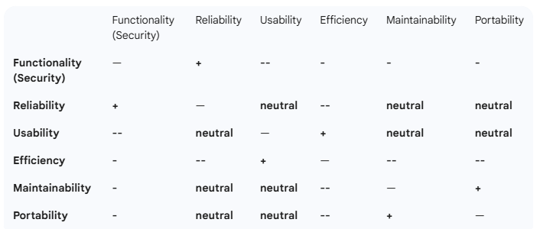
Notes:
1. Security (Functionality) vs. Usability
The Conflict: High security requires complex passwords, biometric scans, and 2-factor authentication.
The Result: While the system is more secure, the user experience becomes "heavier" and less convenient, decreasing Usability.
2. Efficiency vs. Maintainability
The Conflict: To make a program run lightning-fast (Efficiency), developers often use "low-level" optimizations, complex algorithms, or "clever" code tricks.
The Result: This code is usually very hard for a new developer to read or fix, which severely hurts Maintainability.
3. Reliability vs. Efficiency
The Conflict: High Reliability requires redundancy (e.g., keeping three copies of a database) and error-checking routines that run in the background.
The Result: These background checks and redundant systems consume extra CPU and Memory, reducing the overall Efficiency of the software.
4. Portability vs. Efficiency
The Conflict: To make software run on any OS (Portability), you often use a virtual machine layer (like Java) or "generic" code that doesn't use specific hardware features.
The Result: Because the code isn't "tuned" for the specific hardware (like a specific GPU or CPU instruction set), it runs slower than native, non-portable code.

Slide 14
Characteristics of Quality
External
Correctness (?), Usability, Efficiency, Reliability, Integrity, Adaptability, Accuracy, Robustness
Internal
Maintainability, Readability, Testability, Reusability, Portability, Flexibility, Understandability
Notes:
Software has both external and internal quality characteristics. External characteristics
are characteristics that a user of the software product is aware of, including the following:

Slide 15
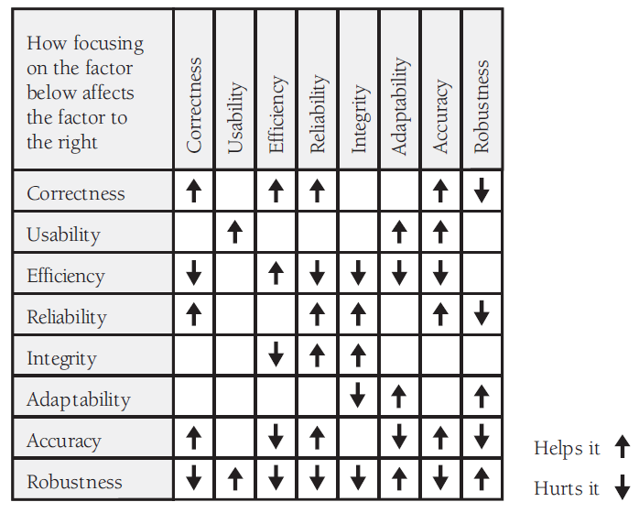
Notes:
Focus on adaptability helps robustness
Focus on correctness hurts robustness
Increases Efficiency: A correct system avoids wasted resources. Errors and bugs often lead to an application running inefficiently, consuming unnecessary CPU, memory, or disk space as it attempts to handle invalid states or processes. Correct code follows the most direct and optimized path to a solution, thereby increasing efficiency.
Example: An e-commerce website with a bug in its search function might run unnecessary database queries, slowing down the entire site. A correct implementation of the search function will execute only the required queries, making it faster and more efficient.
Increases Reliability: A correct system is inherently more reliable because it's less prone to failure. Failures are often caused by logical errors, unhandled exceptions, or bugs that lead to system crashes. When the code is correct, it behaves predictably under a wide range of conditions, reducing the chance of unexpected failures.
Example: A medical device's software must be correct to be reliable. If a bug causes the system to malfunction during a patient's treatment, it's a reliability failure. Correctness ensures it operates as intended, consistently.
Increases Accuracy: Correctness is the foundation of accuracy. If a system's logic is flawed (incorrect), its output will be inaccurate. Accuracy is the precision of a software's output, and a correct system, by definition, produces the right result.
Example: A financial application that calculates interest rates must be correct. If a bug leads to an incorrect calculation, the result will be inaccurate, potentially causing significant financial losses.
How Correctness Reduces Robustness
While correctness is crucial, an overly rigid focus on it can sometimes lead to a decrease in robustness. Robustness is the ability of a system to handle errors gracefully and continue to function, even when faced with invalid inputs or unexpected conditions. Correctness, on the other hand, often assumes inputs are valid and conditions are ideal.
A software component that is "correct" may fail or crash if it receives an input that doesn't match its strict specifications. This is because its code is designed only to handle a specific, correct set of conditions and lacks the additional logic to handle errors or exceptions gracefully. A robust system, by contrast, includes extra code to anticipate and manage these "incorrect" scenarios, preventing a total failure.
Example: A function designed to process a user's age might be "correct" in that it only accepts and processes a positive integer. If a user enters a negative number or a letter, the strictly "correct" function might crash or return an unhandled error. A robust version of this function, however, would include error-handling logic (e.g., a try-catch block) to detect the invalid input and prompt the user to enter a valid age without crashing the application. In this case, the extra code for robustness adds a "controlled imperfection" to the system's simple, "correct" logic.

Slide 16
Notes:
Increases Adaptability: A usable system is often more adaptable because its clear design and user-friendly interface make it easier for users to interact with new or changed features. When a new version of the software is released or the user's environment changes (e.g., a new operating system), the user can quickly figure out how to navigate the new interface and use the new functionalities. The principles of good design—such as clear labeling, consistent navigation, and intuitive controls—transfer well across different contexts and platforms.
Example: An intuitive and well-designed mobile banking app that is easy to use on one platform (like iOS) is likely to be easily adaptable for users on another platform (like Android). The consistent user interface and workflow allow users to adapt to the new environment with little to no learning curve.
Increases Accuracy: Usability directly contributes to accuracy by reducing the likelihood of user errors. A well-designed user interface guides the user, making it difficult to input incorrect data or perform an unintended action. By providing clear instructions, validation feedback, and confirmation prompts, usable systems prevent mistakes before they happen.
Example: A form on a website that requires a user to enter their date of birth. A usable form would use a calendar widget instead of a free text field, which prevents the user from entering an invalid format (e.g., "January 1, 1990" instead of "01/01/1990"). This ensures the data entered is accurate and in the correct format.

Slide 17
Notes:
Decreases Correctness: Chasing maximum efficiency can lead to shortcuts in the code that introduce bugs. Developers might skip thorough validation checks or ignore edge cases to reduce processing time or memory usage, leading to incorrect behavior.
Example: A high-speed sorting algorithm might be optimized for a specific type of data and fail (become incorrect) if it receives a different data type. The developer, prioritizing a 10% speed gain, might not have added the necessary checks, leading to a system that works most of the time but fails on a specific set of inputs.
Decreases Reliability: An overemphasis on efficiency can make a system less reliable. When developers eliminate all "unnecessary" code, they might remove features like redundant checks, backup processes, or graceful degradation routines. This makes the system fragile and prone to failure when faced with an unexpected condition.
Example: A video streaming service might be optimized for efficiency by using a single, low-latency server for all user requests. While this is fast, if that server fails, the entire system goes down, making it unreliable. A more reliable system would use redundant servers, a less efficient but more robust solution.
Decreases Integrity: Efficiency can sometimes be at odds with data integrity. Security and integrity checks, such as data encryption and validation, require processing time and resources. To make a system "faster," a developer might reduce the strength of these checks or remove them entirely, making the system vulnerable.
Example: A database application might disable some integrity constraints to speed up data entry. This could allow for inconsistent or corrupted data to be entered, compromising the overall integrity of the database.
Decreases Adaptability: Highly optimized code is often tightly coupled to a specific environment or set of assumptions to achieve peak performance. This makes it difficult to modify or adapt to new requirements, hardware, or operating systems. Changes to an efficient system can require a complete rewrite rather than simple modifications.
Example: An application with highly optimized, platform-specific code written in Assembly Language for a particular processor might be extremely fast. However, if the company decides to port it to a different processor architecture, the code would be almost impossible to adapt and would need to be rewritten from scratch.
Decreases Accuracy: As with correctness, extreme efficiency can lead to a decrease in accuracy. This is especially true in numerical computations where developers might use less precise data types or algorithms to save processing time and memory, resulting in less accurate outputs.
Example: A financial application might use single-precision floating-point numbers instead of more precise double-precision numbers to save memory and speed up calculations. While this might be efficient, the rounding errors could lead to inaccurate financial reports.

